Slide 1
Exp 18 cell lines
Combining Exp 18 and Exp 12

Slide 2
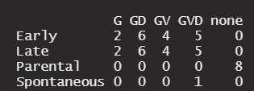
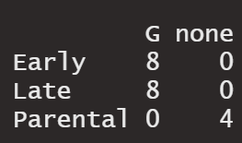
Metadata summary
The three main variables of interest are: Treatment, cell state (Parental, Early and Late), and ligand (FGF2, FLT3, none).
Below we compare each of the Treatment + cell state combinations (GD Early, GD Late, etc) to the Parental state, in both Global and Phospho.
Experiment 18
Experiment 12 (MOLM14 line)
Notes:
G = Gilteritinib, D = Decitabine, V = Venetoclax.

Slide 3
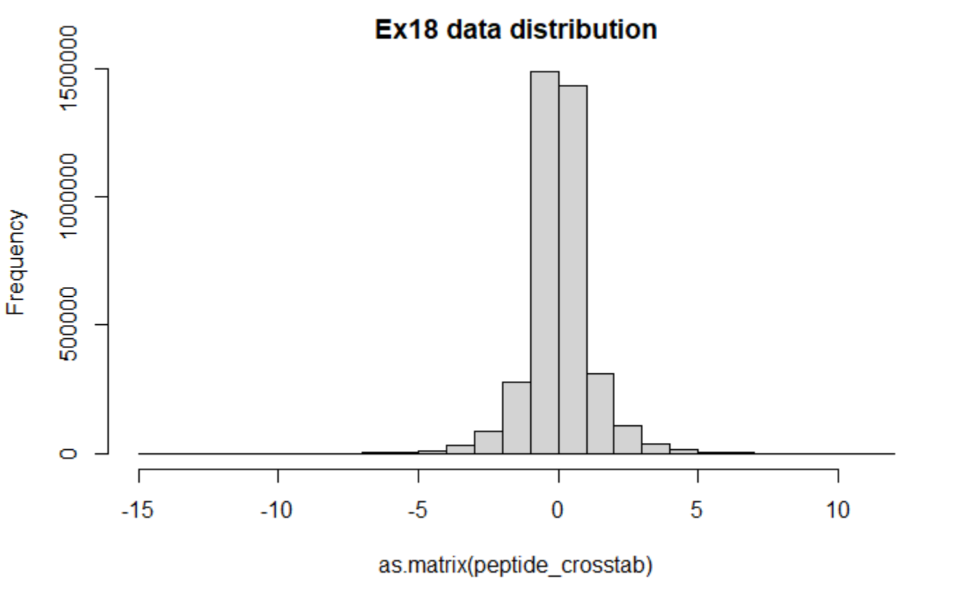
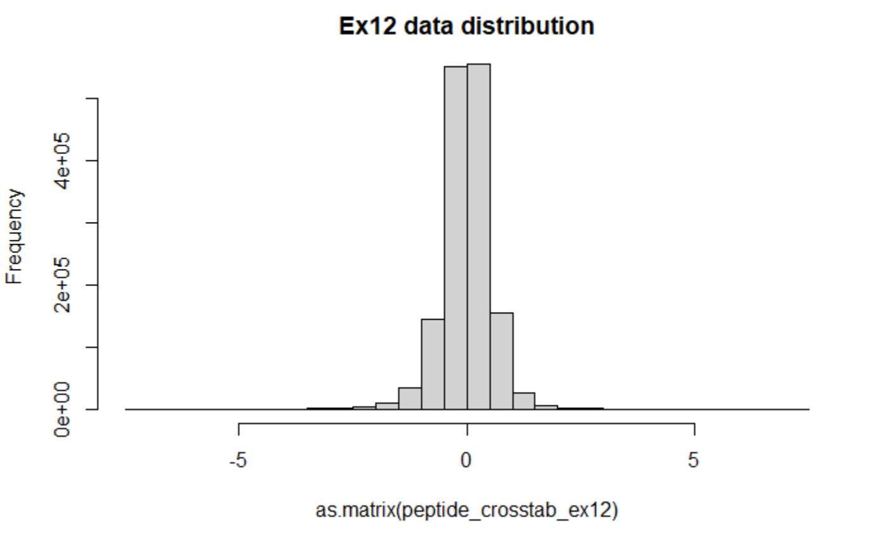
Combining the datasets.
After processing each dataset individually, we combine the two and correct the combined dataset for batch, which includes the batch of both datasets.
The common dataset is composed of peptides identified in both datasets. Below we see that the variance of the datasets differs, being about twice as large in Exp 18.

Slide 4
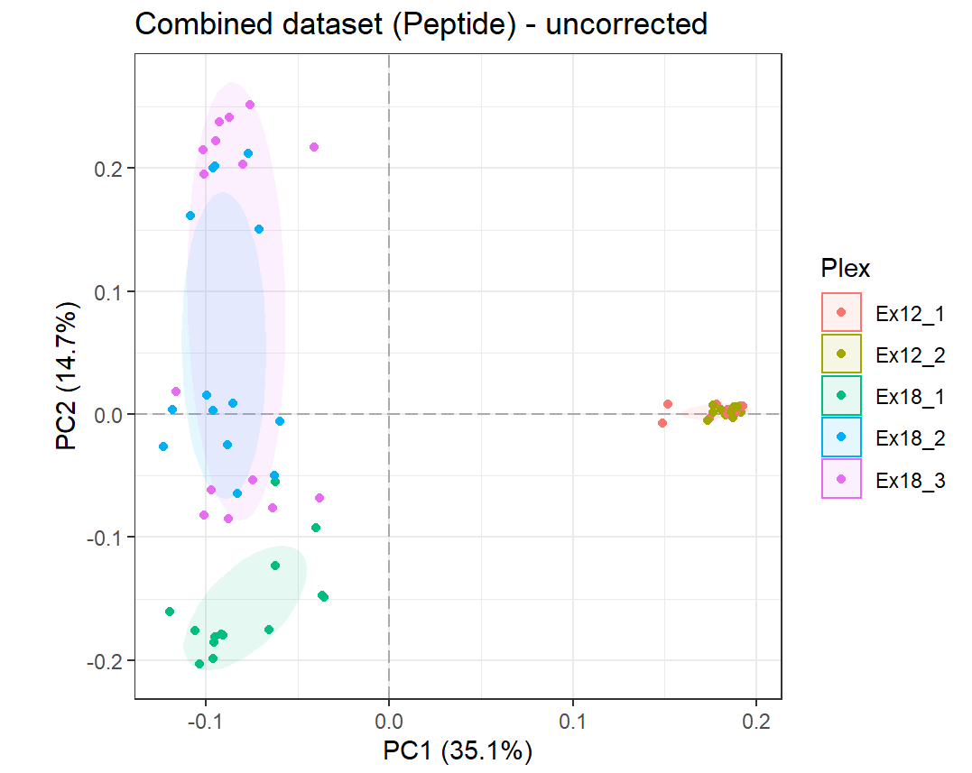
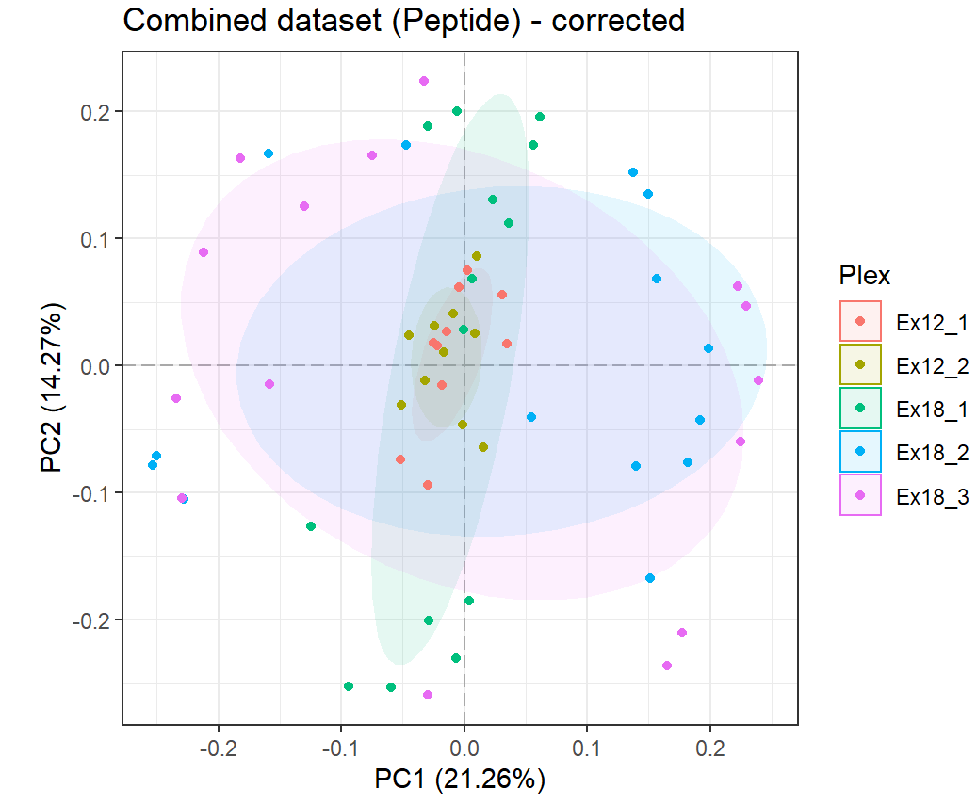
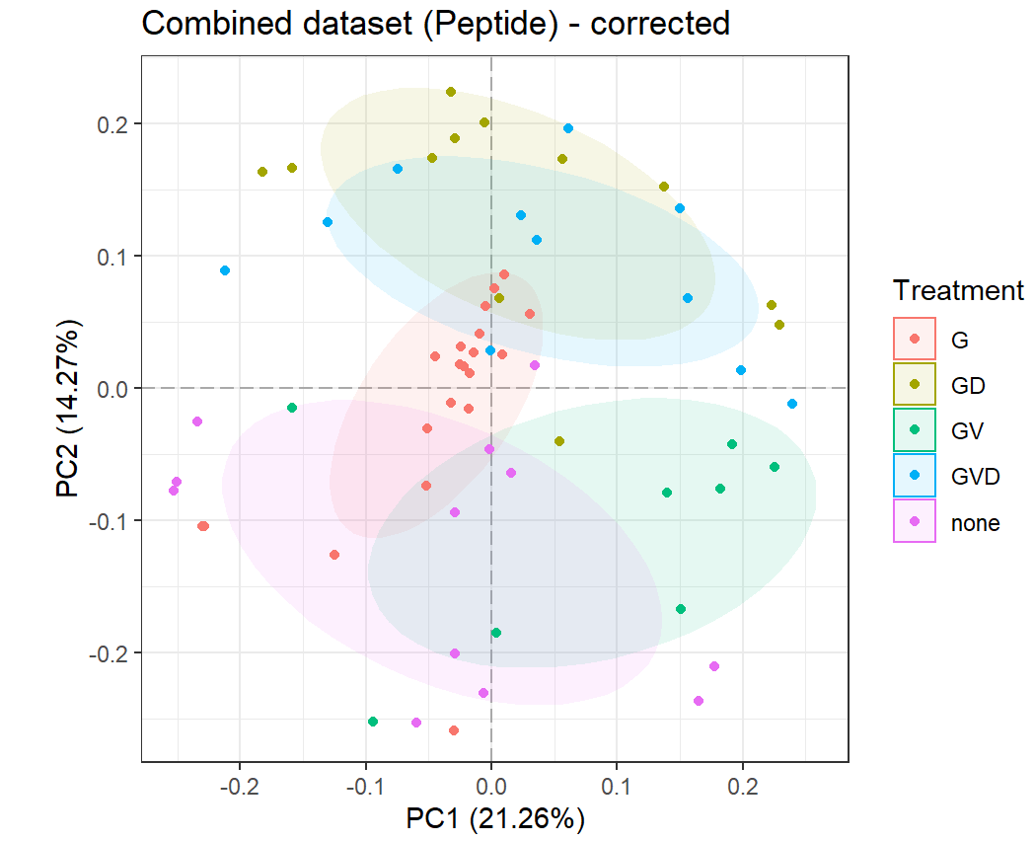
Correcting global.
We correct the datasets together using ComBat, and only using the information of which batch each sample belongs to. That is, no biological information is used.
Notes:
G = Gilteritinib, D = Decitabine, V = Venetoclax.

Slide 5
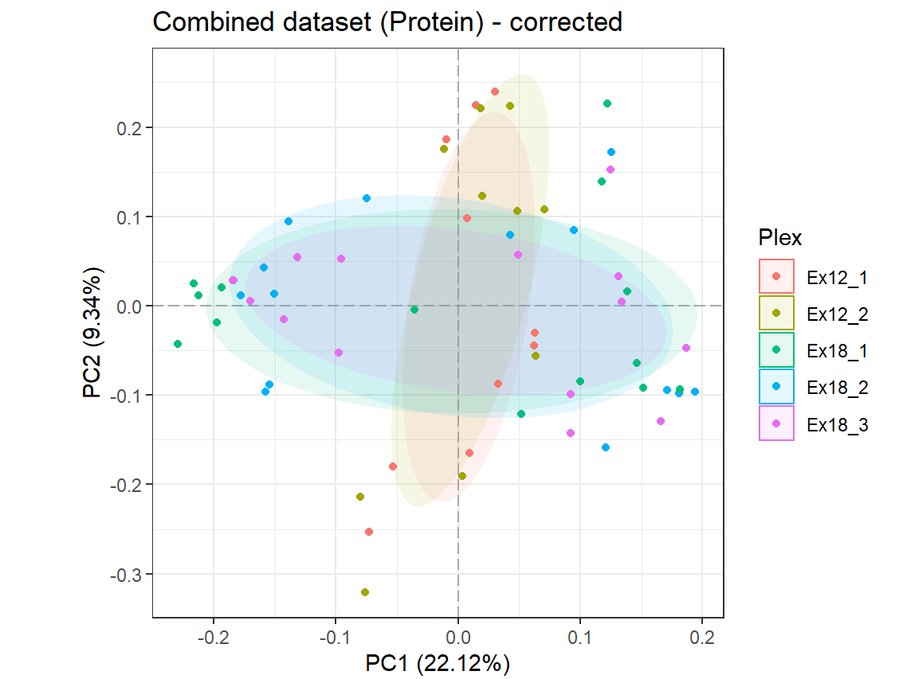
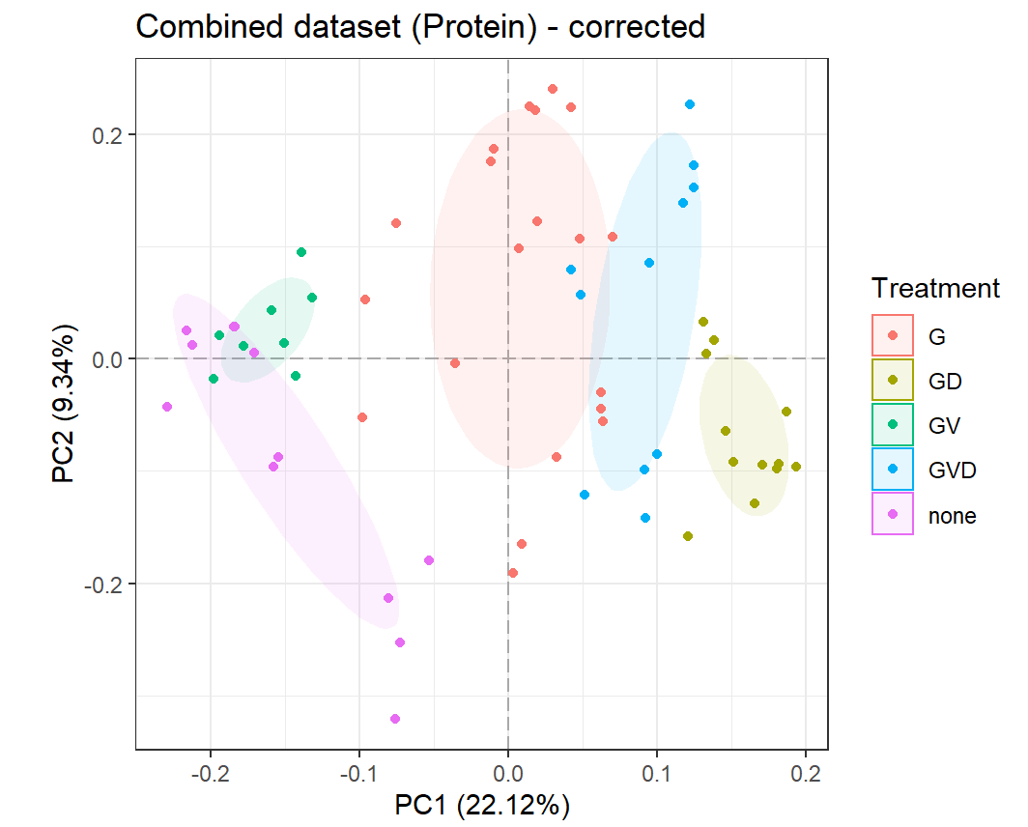
Correcting global – rolling up.
Finally, we roll up the corrected dataset to the commonly identified gene for each peptide.
Notes:
G = Gilteritinib, D = Decitabine, V = Venetoclax.

Slide 6
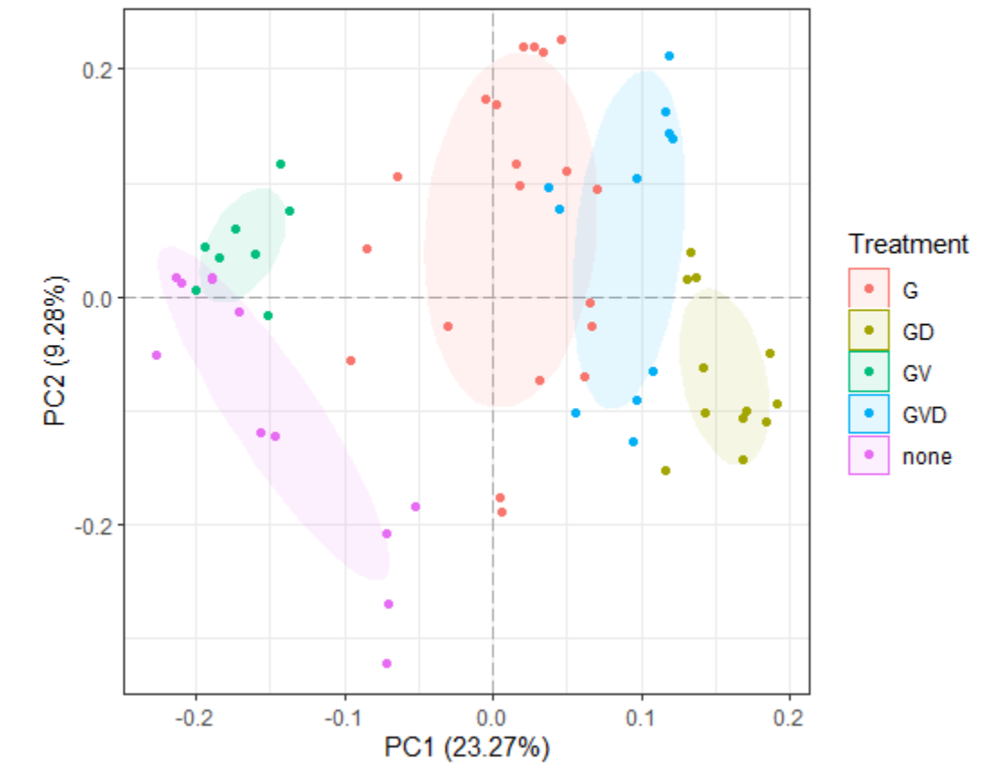
Correcting global – rolling up.
I checked a few different possible ways to combined these. On the right we see the what happens when we combine the two at the GENE level.
Combined at Gene level, then corrected
Notes:
G = Gilteritinib, D = Decitabine, V = Venetoclax.

Slide 7
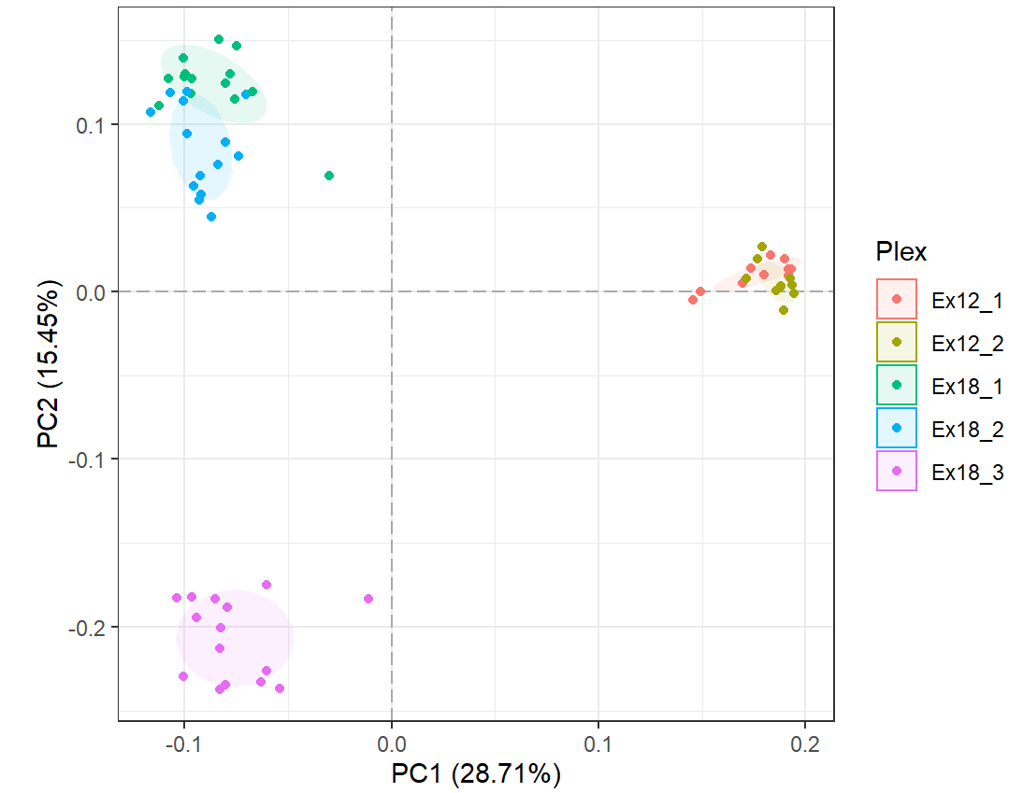
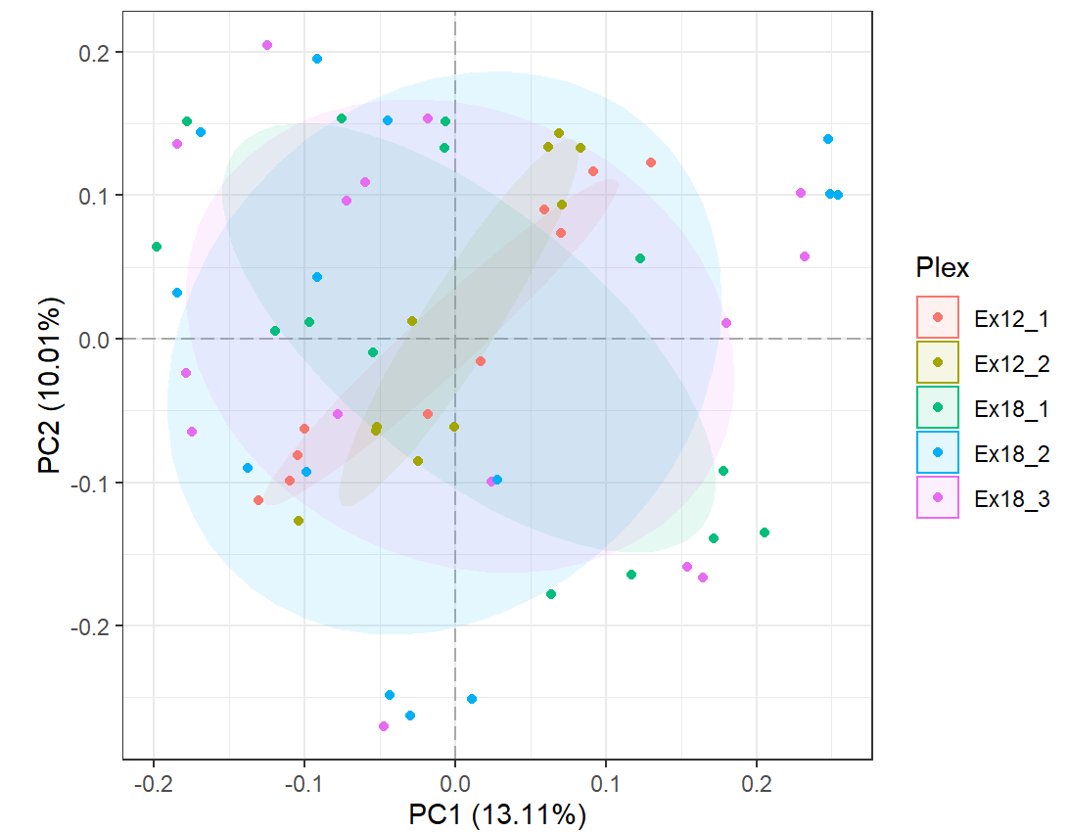
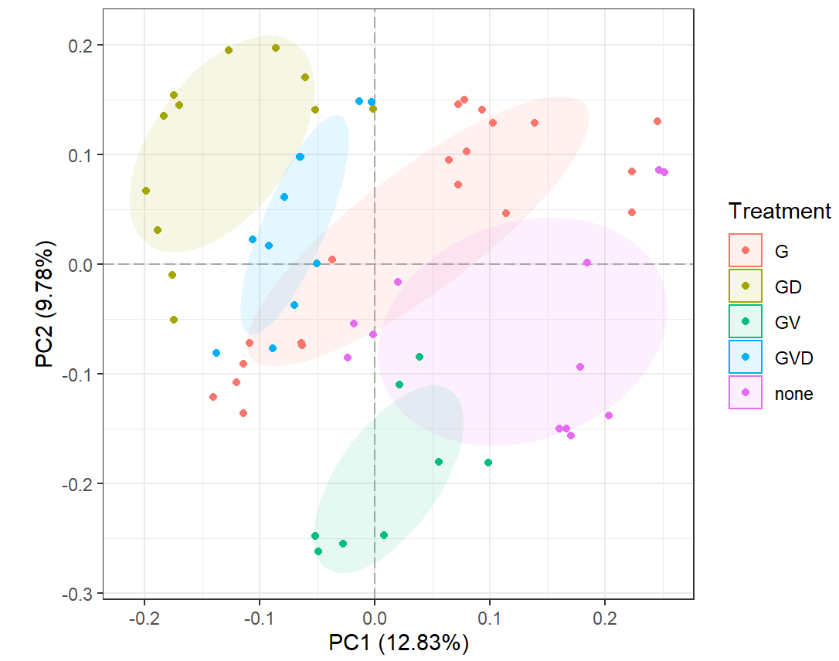
Correcting phospho.
We correct the datasets together using ComBat, and only using the information of which batch each sample belongs to. That is, no biological information is used.
Notes:
G = Gilteritinib, D = Decitabine, V = Venetoclax.
Ligand and Early and late plots here to get a better sense.

